Slide 1
Clean Air Markets Supplementals v1
(CAM/NARR Info Slide, SO2 by year segregation, NOx with Temp Color Map, Polynomial (instead of linear) fit graphs, progress with model emissions/temp graphs)

Slide 2
Informational Slide
Clean Air Markets Data: The Clean Air Markets Division (CAMD) of the EPA is one of 4 divisions within the EPA’s Office of Atmospheric Programs. The Emissions Monitoring Branch of the CAMD collects quarterly reports from states and industry and manages the standard for out-of-the-stack monitoring equipment. This data is then made available to the public by query for the entire US, aggregated by stack, facility, state, region, and nation, for multiple substances such as CO2, NO2, and SO2, available hourly, daily, monthly or yearly. In this case all three substances were taken for their state or region on a daily basis.
NARR Temperature: The temperature extracted from the North American Regional Reanalysis is the temperature at the point of geographic center of the state or region, at 2 meters above ground-level, at 2PM Eastern Standard Time for each day.

Slide 3
EPA Region 1 SO2 segregated by year

Slide 4
EPA Region 2 SO2 Segregated by year

Slide 5
EPA Region 3 SO2 segregated by year

Slide 6
Indiana SO2 Segregated by year

Slide 7
Kentucky SO2 Segregated by Year

Slide 8
Ohio SO2 Segregated by year

Slide 9
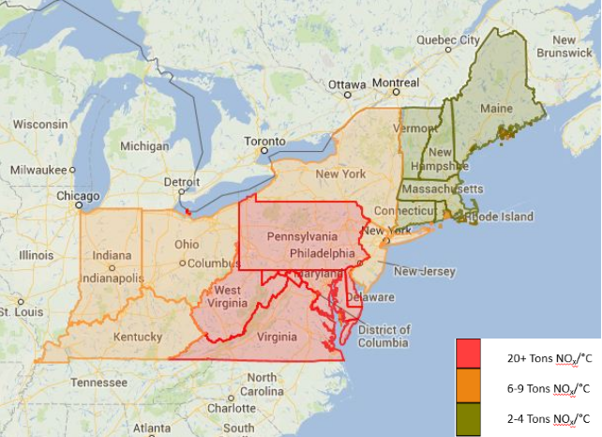
NOx Map (And the reason why I don’t have Marc’s job…)

Slide 10
EPA Region 1 Polynomial Fits Graphs

Slide 11
EPA Region 2 Polynomial Fit Graphs

Slide 12
EPA Region 3 Polynomial Fit Graphs

Slide 13
Indiana Polynomial Fit Graphs

Slide 14
Kentucky Polynomial Fit Graphs

Slide 15
Ohio Polynomial Fit Graphs

Slide 16
2069 Emissions and Temperature
This is hard to do so far. The model output calculated values that don’t seem to be temperature dependent (at least not complexly). Example:
Temp (deg C) NOx (lbs)
Temp (deg C) NOx (lbs)
3.207574 | 38777.07
5.080164 | 38777.07
7.721216 | 38777.07
As you can see, there is no relationship, and there are a lot of horizontal lines on a trend graph.
There are also quite a few zeros in the emissions column, somehow generated by the model.
12.36917 | 0
12.30749 | 0
12.24841 | 34800.71
12.18182 | 34800.71
And as you can see, temperature is higher in the right example, but emissions are higher in the left, which would make a negative correlation between the two, which we know to be untrue. But obviously this isn’t representative of all of the data. Just no trends can be seen.

